Slide 1
Leadership Development Programs

Slide 2
Biggest leadership challenges facing CEOs today
Hiring and retaining talent
Managing morale
Impact of COVID-19
Navigating business transition
Returning to growth
Supply chain disruption
The need for organizational readiness to execute has never been greater.

Slide 3
The War for Talent & The Great Resignation
Investing in employee development is more critical than ever
52% of North American workers are looking for a new position in 2021.
Pre-COVID U.S. average voluntary turnover rate was about 15%.
Microsoft Work Trend Index, 2021
61% of women are planning a major career change post-pandemic. This comes at a time when businesses have been hyper focused on advancing women and diversity; significant attrition could undo some of the progress made.
Forbes, 2020
The average cost to replace a new employee is estimated to be 33% of the cost of their salary; given a U.S. median salary of $47,000, the cost to hire and train a new employee is $15,500.
Work Institute’s Retention Report, 2019

Slide 4
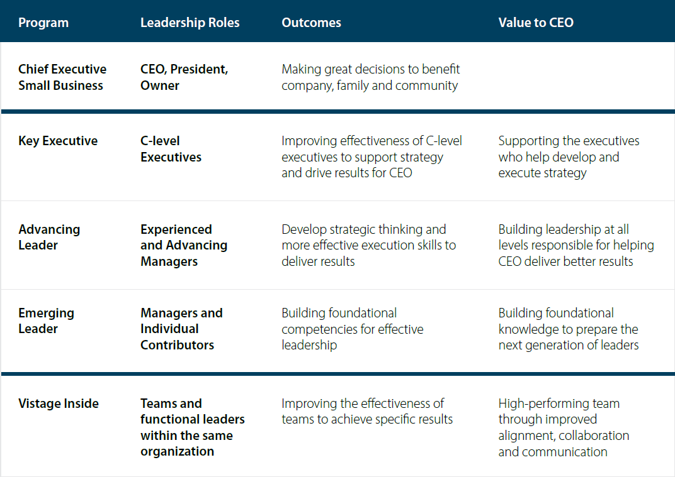
Vistage programs develop the leaders CEOs depend on.
Each program is purposefully designed and adapted to develop leaders operating across SMB organizations.

Slide 5
Key Executive Program
The Key Executive Program develops C-level executives that the CEO relies on to contribute to the strategy and drive results for the business.
Leadership Development for:
Direct report to the CEO such as C-level exec or SVP
Benefits:
Succession Planning
Strategic Alignment
Business and Leadership Optimization
Better Outcomes
Program includes:
Monthly, full-day meetings
Member Driven Development
Vistage Speaker sessions and workshops
Optional 121s with a trusted Vistage Chair
Download
Key Executive Program Overview

Slide 6
Advancing Leader Program
The Advancing Leader Program challenges experienced managers to become more effective through strategic thinking, communication and collaboration to achieve better results.
Leadership Development for:
2+ years in a leadership role such as director, VP, supervisor
Benefits:
Optimized execution
Improved collaboration and effectiveness
Increased employee retention
Enhanced recognition and career advancement
Program includes:
Bimonthly, full day meetings
Expert Vistage speakers
Application-based learning tied to existing initiatives
Cross-Functional Collaboration
Adapted Issue Processing
Download
Advancing Leader Program Overview

Slide 7
Emerging Leader Program
The Emerging Leader Program develops high-potential leaders by building foundational leadership competencies to prepare them for the next level.
Leadership Development for:
New to a leadership role or high-potential individual contributor such as manager, analyst, associate
Benefits:
Enhanced retention and advancement within organization
Improved Execution
Enhanced Culture
Equips managers with foundational leadership skills
Program includes:
12 bimonthly, full-day meetings
Curriculum-based program to develop leadership competencies
Expert Vistage Speakers
Mentorship Program
Download
Emerging Leader Program Overview

Slide 8
Vistage Inside Program
The Vistage Inside Program is fully customizable to improve the performance and collaboration among teams within a single organization to produce better outcomes.
Leadership Development for:
Management team or leaders from the same company who are want to achieve specific goals or results
Benefits:
Delivers immediate impact
Builds trust and collaboration across teams for improved alignment
Flexible configuration to meet organization’s needs
Improved employee engagement and retention
Program can be customized to include:
Full or half-day meetings based on desired outcomes
As many leaders as necessary
Expert Vistage Speakers and 121 sessions to drive specific results
Issue Processing and group exercises
Download
Vistage Inside Program Overview

Slide 9
To learn how you can leverage Vistage programs to develop your leaders,
contact your Chair.
Thank you!

