Slide 1
Great Teams: 16 Things High Performing Organizations Do Differently by Don Yaeger
Summary Slides

Slide 2
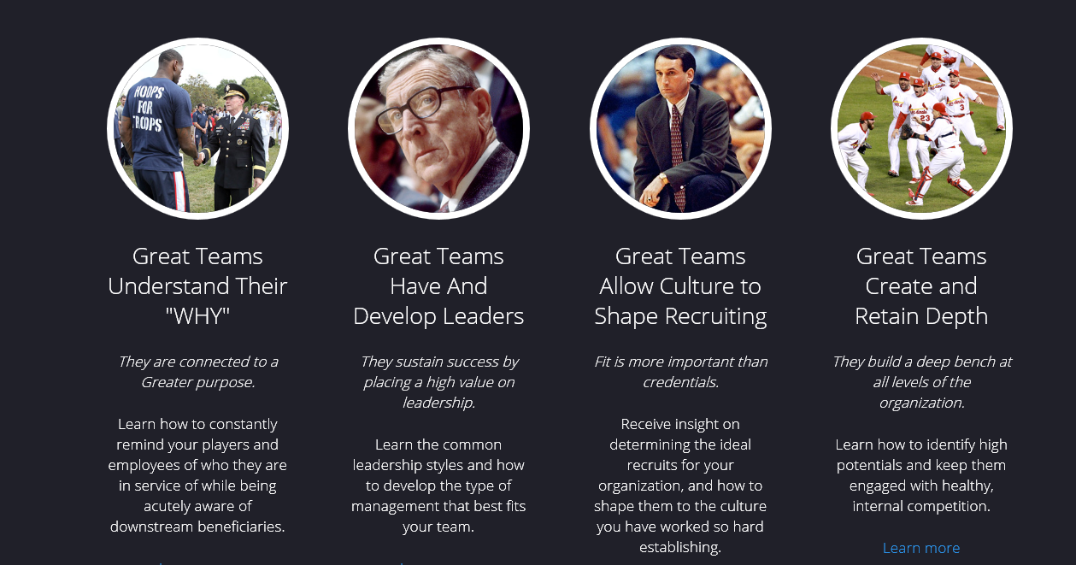
16 Lessons Of Great Teams
Source: Great Teams by Don Yaeger

Slide 3
16 Lessons Of Great Teams
Source: Great Teams by Don Yaeger

Slide 4
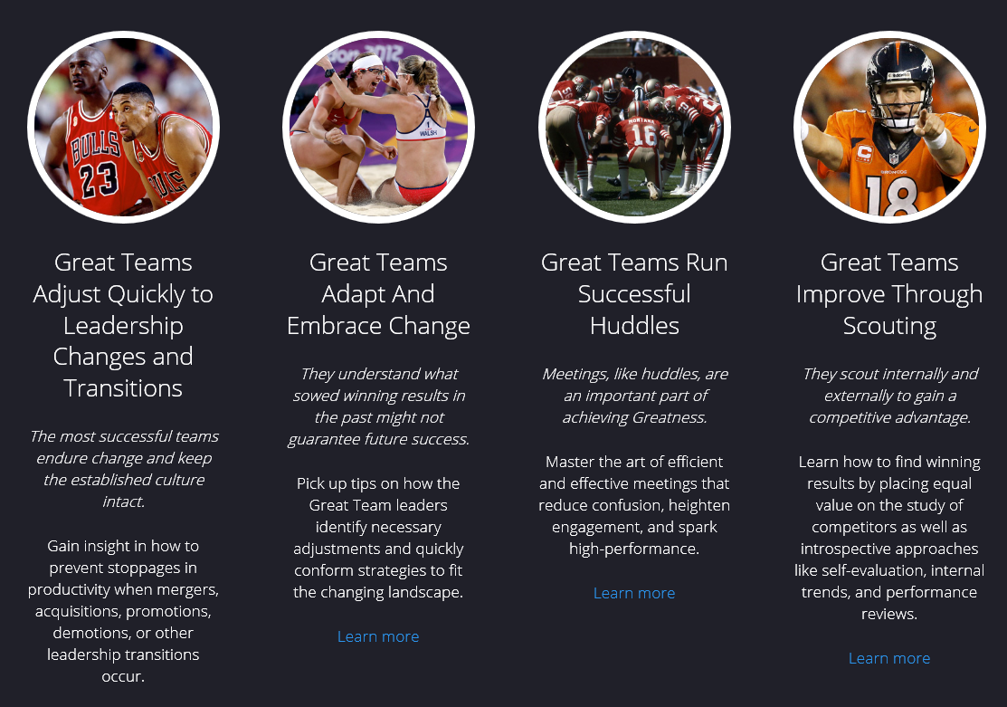
16 Lessons Of Great Teams
Source: Great Teams by Don Yaeger

Slide 5
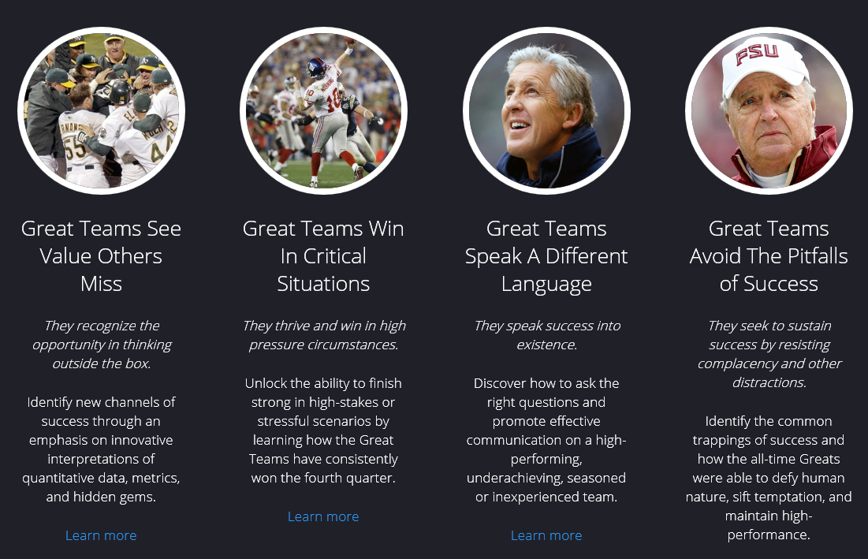
16 Lessons Of Great Teams
Source: Great Teams by Don Yaeger

