Slide 1
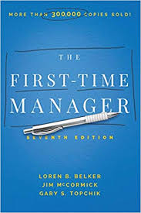

Slide 2
So Your Going To Manage People:
Management Is Not For Everyone
20% of people don’t even want to consider it
  “What if I say no” concerns
Some people have a hard time leading and leveraging a team – The Omnipotent One
The Chosen
  Some people have shortcuts
  Best are managers chosen for natural ability

Slide 3
So You’re Going To Manage People:
Starting Out
Not everyone will be thrilled for you
Some will test you early on
Many will take a “wait and see” attitude
You’ll be measured against your predecessor (good and bad)
Don’t make changes right away; practice restraint
Be honest; don’t fake it or spin
Focus your efforts “down and out” not just “up”

Slide 4
So You’re Going To Manage People
Starting Out
Settle In
Settle In Properly – Let people get used to the idea; exercise restraint
Use
Use Your Authority Judiciously
Don’t ignore
Don’t ignore the “Personal Touch”
Manage
Manage existing friendships wisely
Build
Build your area to be successful
Manage
Manage your moods – navigate the ups and downs
Manage
Manage your feelings – be an authentic adult human

Slide 5
So You’re Going To Manage People
Show Your Appreciation
Be Specific – if managers want certain behaviors repeated, they need to be specific in the type of positive feedback they give. The more detailed the manager is, the more likely the action or behavior will be repeated
Describe The Impact - Let them know their work ties into the bigger picture or the larger scheme of things
Don’t Overdo it – make sure praise is on target and deserved or it will lose its value

Slide 6
So You’re Going To Manage People
Be An Active Listener
Practice Active not Passive listening
  People like others who pay attention to them
  Stay focused and talk less
Add well placed comments to keep up momentum, e.g., “That’s interesting.”
Ask clarifying questions
Pay attention to words, body language and tone of voice
Understand the need for conversation terminators

Slide 7
So Your Going To Manage People:
The New Manager’s Job
8 Responsibilities:
Hiring
Communicating
Planning Work
Organizing Resources
Training
Monitoring Results
Evaluating Performance
Firing

Slide 8
So You’re Going To Manage People:
Dealing With Your Superiors
Loyalty is expected but know your limits and seek clarification when necessary
  You will be expected to ”tow the line” publicly
Responsibility to Your Manager
  Keep them informed
  Be considerate of their time
  Be well-prepared
  Be willing to consider their point-of-view

Slide 9
So You’re Going To Manage People
Dealing With Your Superiors
Monopolizer In charge Direct Quick decisions Organized Be ready with facts | Methodical Analytical Wants lots of information Prizes Accuracy Slow decisions Be ready to support your position
Motivator Fun to be around Charismatic and social High energy May not follow-through Be ready for small talk | Mixer Dedicated and loyal Patient and understanding Conflict-adverse Dislikes change Needs you to be a team player
Know your Manager’s Personality Style:

Slide 10
So You’re Going To Manage People
Dealing With Your Superiors
How does he or she prefer to process info? Verbally In writing Graphically In presentations | What level of detail doe he or she prefer? Extensive detail Overviews and summaries Big concepts
What is his or her innate level of immediacy? Wants new info right away Prefers you to process and consider info before you share it with them Would rather receive info at a regular time in the day or week | What does and does not interest him or her? What fascinates him or her? What does not interest him or her? What causes him or her to “check-out”
Your Supervisor’s Preferences:

Slide 11

So You’re Going To Manage People:
Choosing a Managerial Style of Your Own
Control is:
Telling employees what to do
Showing them how to do it
Making sure that the work is done
Encouragement is:
Motivating
Listening
Running interference so employees can do what is expected of them

Slide 12
So You’re Going To Manage People:
Choosing a Managerial Style of your Own
5 Types of Employees:
Type A – motivated to do well but lacks the skill to succeed; needs mostly control from you
Type B – has lost motivation but has the skills to do the job; needs lots of encouragement
Type C – performs very well and is also motivated; needs little control and encouragement
Type D – lacks both ability and willingness to perform; needs lots of control and encouragement
Type E – has medium amounts of skill and motivation; needs medium amounts of control and encouragement

Slide 13
Tackling Your New Duties:
Building A Team Dynamic
6 Factors Essential To Build a Team Dynamic:
Open communication
Empowerment
Clear roles and responsibilities
Goal clarity
An effective leader
A reward and accountability system for both individual and team members and for the entire team

Slide 14
Tackling Your New Duties:
Building A Team Dynamic
Effective Team Leadership:
Set clear goals for each team member.
Give clear directions for those who need it.
Share personal examples in order to relate to the team
Emphasize the positive rather than the negative
Give continual feedback to each member and the team
Uses small successes to build cohesiveness
Practice what you say
Express the organization’s and your appreciation through rewards
Develop a constructive relationship with the team
Make change happen for the better through encouraging creativity and innovation
Encourage self-reliance and professional development
Express team members to express their views during conflict and share your thoughts with them
Help your team see its connection to the larger organization, customers and community

Slide 15
Tackling Your New Duties:
Management versus Leadership
Management
More top down and directive
More structured
Focuses on methods
More directive
More focused on correcting
Determines methods
Leadership
More bottom up and participative
Less structured
Focuses on exceptions
More of a coaching dynamic
More focused on affirming
Establishes goals then lets team members determine their methods

Slide 16
Tackling Your New Duties:
Managing Challenging Behavior Types
The Attacker – always disagrees and undermines and blocks progress
The Comic – to focused on entertaining others
The Deserter – mentally or physically leaves the team
The Limelight Seeker – takes credit for everything and brags too much
The Moonlighter – treats job as a secondary to other some other interest
The Not-My-Jobber – do nothing unless it is in their job description
The Bleeding Heart - feels like they have given their life for the company, received nothing in return and wants everyone to know it
The Complainer – likes to moan and complain about everything

Slide 17
Tackling Your New Duties:
Hiring and Interviewing
Interview questions to avoid :
Why do you want work here?
What makes you think you’re qualified for this job?
Are you interested in this job because of the salary?
Sample questions to ask:
What did you like best about your last job?
What did you like least about your last job?
Tell me about your last manager?
How did your last job allow you to grow professionally?
How would you have restructured your lats job if you could?

Slide 18
Tackling Your New Duties
Hiring and Interviewing: The Attitude Talk

Slide 19
Tackling Your New Duties:
Training team Members

Slide 20
Tackling Your New Duties:
Training Team Members
The Improvement Seed

Slide 21
Tackling Your New Duties:
Resistance to Change Tips
First, accept that resistance to change is a normal human response and is always subjective
Identify the most resistant individuals up front and try and get them on your side
The fewer unknows the less resistance! (be clear, concise and honest)
Provide accurate information
Explain why the change is occurring and point out the benefits to them
Ask for their feedback on the best way to implement change

Slide 22
Tackling Your New Duties:
Disciplining The Employee
Tips
Discipline/Constructive feedback should be done in private
Never make it personal – focus on performance not the person
Give them the benefit of the doubt – assume they want to be successful
Address performance issue as if there was some possible misunderstanding about how the work should be done
Be clear that performance is not up to standards
Have a conversation not a monologue; encourage their participation in the discussion but manage this carefully
Put them at ease with the power dynamic

Slide 23
Tackling Your New Duties
Oh My God! I Can’t Fire Anyone:
Questions To Ask Before Final Step Of Termination:
Is it possible this employee could handle some other job in your own area that is currently available?
If an opening is coming up in another area, can the employee make the contribution there?
Is this a situation where a person has been hired for the wrong job? Does the company gain anything by firing someone who could be useful somewhere else?
Is your company large enough that the employee could be moved to another area with no stigma?

Slide 24
Tackling Your New Duties
Oh My God! I Can’t Fire Anyone:
Managing Dismissal Drama:
Schedule termination discussion for late Friday afternoon
Any money owed should be given at the end of the dismissal discussion
Keep your intention to fire the person as confidential as possible
If you are worried about the potential response, have a colleague with you in the meeting
  Summarize details of conversation in writing (for internal purposes) in case needed at a later date
Start the dismissal interview with a brief review of what has happened – don’t drag this out (see next page)

Slide 25
Tackling Your New Duties
Oh My God! I Can’t Fire Anyone:
Sample Dismissal Language

Slide 26
Tackling Your New Duties
Having Legal Awareness:
Sexual Harassment Danger Signs

Slide 27
Tackling Your New Duties
Having Legal Awareness:
Violence In The Workplace Warning Signs

Slide 28
Working With People, Building Relationships and Managing Risks:
No Secrets

Slide 29
Working With People, Building Relationships and Managing Risks
The Human Resources Dept

Slide 30
Working With People, Building Relationships and Managing Risks:
The Current State of Loyalty

Slide 31
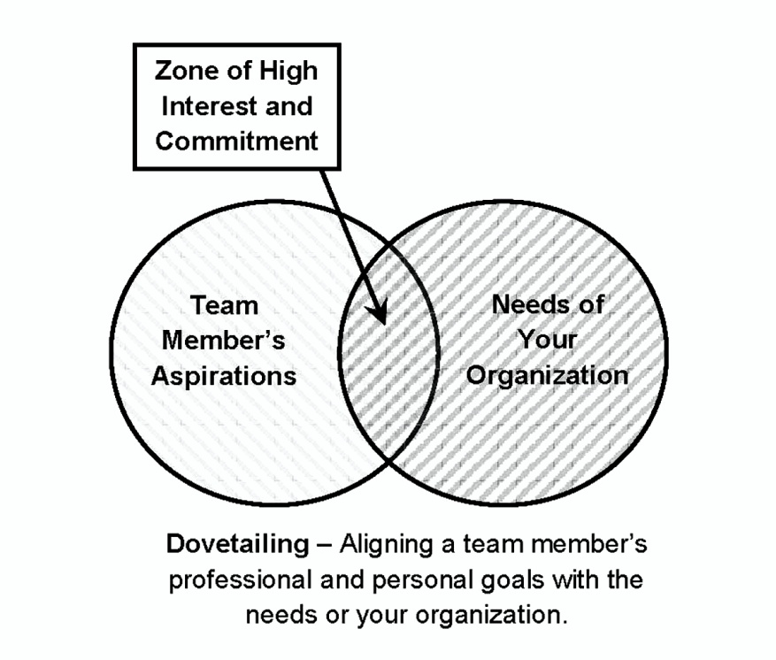
Working With People, Building Relationships and Managing Risks:
Is There Such A Thing As Motivation?
Dovetailing

Slide 32
Working With People, Building Relationships and Managing Risks:
Understanding Risk Inclination
Determining RQs
Physical Risks
Career Risks
Financial Risks
Social Risks
Intellectual Risks
Creative Risks
Relationship Risks
Emotional Risks
Spiritual Risks
Understand this about yourself and
others and manage accordingly

Slide 33
Working With People, Building Relationships and Managing Risks:
Encouraging Initiative and Innovation
Responding To Flawed Decisions/Actions
Review the circumstances of the situation with the team member(s) involved
Do not be critical
Explain that your goal is to make sure everyone learns from the experience and that the mistake is not repeated
Drive the conversation toward what can be done differently next time to get a better outcome
Make it clear that while the team members cannot afford to make the same mistake again, you appreciate their willingness to take initiative and want to encourage them to continue to do so.

Slide 34
Working With People, Building Relationships and Managing Risks:
Improving Outcomes
Intelligent Risk Taking – 6 Steps
Identifying the risk
Assessing the likely outcomes
  Best case
  Middle case
  Worst case
Improving the chances of success
Updating the assessment of likely outcomes
Conducting a disaster check
  Can you live with the worst possible outcome?
Deciding and proceeding

Slide 35
The Generation Gap
Insights
 | Years Born | Traits | Motivators | They Value | Incentives and Rewards
Millennials | 1977-1995 | Optimistic Multi-taskers Expect flexibility | Being valued A sense of progress Opinion valued A mission they believe in | Liking their work Being well-informed Interactions w/Senior Leaders Skills training Opportunities to grow and advance Feedback | Compensation and benefits Personal time Flexibility
Gen X | 1965-1976 | Drive Ambition Prefer Autonomy | Bonuses/stock Flexibility | Flexibility Working independently Self-improvement Regular and public recognition | Compensation Flexibility Telecommuting Tuition reimbursement
Baby Boomers | 1946-1964 | Ambitious Goal-oriented Identities drawn from work | Compensation Promotions Recognition Retirement funding | Expertise being recognized and valued Titles | Compensation Occasional feedback Authority Perks

Slide 36
Working With People, Building Relationships and Managing Risks:
Managing Remote Employees
Expectations
Performance Goals
Reporting requirements
Availability – theirs and yours
Response times – theirs and yours
Work hours per week

Slide 37
Managing Remote Employees
Expectations
Social Media In The Workplace
4 Different Aspects of Work-Related Use
Official use – statements on behalf of company (PR)
Professional use at work – social media as part of pursuing the organization’s mission, e.g., research recruiting, etc.
Personal use at work – accessing personal social media accounts during work hours on employer owned devices
Personal use on personal time and personal devices – use of a personal nature that does not take place during work hours or on employer’s devices

Slide 38
Job Descriptions, Performance Appraisals, and Salary Admin.
Writing Job Descriptions
3 Tiers
Technical skills and knowledge
Behaviors
Interpersonal skills

Slide 39
Job Descriptions, Performance Appraisals, and Salary Admin.
Doing Performance Appraisals
Manager’s Responsibilities
Set goals and objectives so employees know what is expected of them
Provide training and coaching to help employees succeed
Provide ongoing feedback on performance
Prepare the paperwork for review
Conduct the review in a timely manner
Understand and communicate the review importance
Be thorough and base review on the employee’s performance, not on your own attitude

Slide 40
Job Descriptions, Performance Appraisals, and Salary Admin.
Doing Performance Appraisals
Meeting Agenda
What areas of this employee’s performance or attitude should you mention?
What areas are not covered in the performance appraisal?
What are some items of personal interest about this employee you should bring up?
What questions should you ask that are likely to generate some conversation and opinions about the work?
How can you help this employee do a better job? What are the areas in which this employee will be self-motivated?
How can you let this employee know he/she is important to you personally, not just for the work performed?
How does this employee fit in the company’s future plans? Is this person promotable? What can you do to help him/her?

Slide 41
Job Descriptions, Performance Appraisals, and Salary Admin.
Doing Performance Appraisals
Post Appraisal Checklist:
Explained the purpose of the interview
Found out the employee’s feelings on his/her performance
Allowed the employee to do a majority of the talking
Pointed out where the employee is doing well
Offered suggestions for improving performance and asked the employee for suggestions
Put the employee at ease by creating a relaxed environment
Agreed on action plans for improving performance (if necessary)
Set a time frame for improving performance (if necessary)

Slide 42
Job Descriptions, Performance Appraisals, and Salary Admin.
Talent Management Matrix Process
Identify planning time horizon
List each member of your team
List the person’s current capabilities
List their required future capabilities
Identify missing capabilities
Establish actions to develop missing capabilities
Assess whether or not individual has a realistic chance of acquiring missing capabilities

Slide 43
Improving and Developing Yourself
Having Emotional Intelligence
Emotional Smarts Questions:
Can you walk into a room and sense the mood?
Can you recognize the emotional state of others?
Do you know when you are becoming emotional and can you control it if you want?
Under stressful and chaotic situations, can you evoke positive emotions in others?
Can you and do you express to others how you are feeling and what your emotions are?

Slide 44
Improving and Developing Yourself:
Having Emotional Intelligence
The EQ Test (rate 1-10 with 10 being highest)

Slide 45
Improving and Developing Yourself
Developing A Positive Self Image
4 Decision Making Methods
Solo decision-making – you make the decision yourself
Participative decision-making – make decisions with input from your staff
A delegated decision – you allow the team to make the decision for you
An elevated decision – decision made by someone above you
Know when to use the right method

Slide 46
Improving and Developing Yourself
Managing Your Own Time
Time Management Tips:
Recognize we all have the same amount of time – 168 hours per week
Set deadlines for your projects
Remember the difference between of something being urgent vs. being important
Try keeping a weekly record of your time
Plan your day
Plan your week
Follow the 70/30 Rule - schedule no more than 70% of your day
Schedule time for sending and returning phone calls, emails, etc.,
Don’t wait for perfect time for you to be in the mood of working on high priority items
Reward yourself when you get an A-Priority item completed
Develop the on-time habit
Consider working from somewhere where people can’t easily find you when you need to work uninterrupted on an important task

Slide 47
Improving and Developing Yourself:
Your Best Friend: Delegation
The Delegation Steps
Start off by analyzing which of your current tasks, projects, or jobs you could possibly delegate
Decide to whom you can delegate the task. Consider who would be the most motivated by the opportunity, who has time, who either has the skill level or could acquire the skills, and who has asked for additional responsibilities.
Once you make up your mind, sit down with the employee and describe as many details of the task as possible. Also point out the benefits of taking on delegation.
Come to agreement on the goal of the task and timeline to be followed. This is vital and should be in writing.
Finally, discuss how you are going to monitor the employee’s progress.

Slide 48
Improving and Developing Yourself:
Managing, Participating In, And Leading Meetings
Mistake Managers Make
Having an opinion on every issue
Remaining silent during the entire meeting
Saying something uncomplimentary in a meeting about anyone on your staff
Viewing meetings as a competition with your colleagues at the same level
Always waiting to see which way the boss is going so your opinions are the same
Lacking the courage to take a position different than your boss
Not letting those you outrank speak up before you add your opinion
Rubber stamping work made by team that supports your own view

Slide 49
Improving and Developing Yourself:
Managing, Participating In, And Leading Meetings
How To Lead A Meeting
Circulate an agenda in advance of meeting
Distribute minutes of previous meeting in advance of meeting
Have a clear start and stop time
Keep your cool; don’t let anyone press the panic button
Be courteous to all meeting participants; Avoid putting people down
Act as a facilitator, not as a dictator
Keep to the subject
Don’t cut people off before they’ve had their say, but don’t allow them to drift away from the subject
Always deal with the problems at hand
Don’t allow the same points to be expressed repeatedly
Don’t get involved in personalities even if others do
Be better organized than the participants
Develop thoughtful relationship with others so they come to you with important issue beforehand; avoid unpleasant surprises
Be fair to everyone, even minority opinions that are unlikely to prevail

Slide 50
Improving and Developing Yourself:
Managing, Participating In, And Leading Meetings
Other Meeting tips
Establish groundrules at the beginning of the meeting
Ask someone to capture ideas and positions on a white board or flip chart
When multiple participants express a desire to talk, acknowledge their desire and let them know they will be heard in a certain order
If discussion becomes just between two participants and doesn’t involve others in attendance encourage them to continue their discussion at another time
Ask a person before they speak how much time is needed for their comments. If they exceed this time limit, then gently stop them and ask how much more time they will need
Spend 5-10 minutes at the end debriefing the meeting
Have a purpose and goals on top of your agenda
Only invite individuals who really should be there
Keep meetings as short as possible
Prepare a follow-up action plan with action items for different participants
Schedule meetings reluctantly and pride yourself on making them quick and efficient

Slide 51

The Complete Person
Coping With Stress
Typical Work-Related Stressors

Slide 52
The Complete Person:
Coping With Stress
React To the Problem , Not the Stress

Slide 53
The Complete:
Person
A Touch of Class

Slide 54
The Complete Person:
A Touch of Class

Slide 55
The Complete Person:
A Touch of Class

Slide 56

Ed Robinson
President & Founder
Capacity Building Solutions Inc.
301/624-5686
robin_ed@capacity-building.com

